Slide 1
Introduction to Artificial Intelligence & Machine Learning for Space Biology

Slide 2
Machine learning vs artificial intelligence
Artificial Intelligence (AI): a broad field of computer science focused on creating systems or machines that can perform tasks that typically require human intelligence.
AI systems aim to mimic human cognitive functions such as learning, reasoning, problem-solving, perception, and language understanding.
Machine Learning (ML): a subset of AI that focuses on developing algorithms and models that enable computers to learn from data and make predictions or decisions based on that data.
ML algorithms learn patterns and relationships from large datasets without being explicitly programmed, allowing them to improve performance over time.
In biological research, we may use both ML and AI techniques to uncover biological patterns and complexity.

Slide 3


Types of machine learning
Supervised Learning: algorithm learns from labeled data
Example: Predicting house prices based on features like size, location, and number of bedrooms, using historical data where prices are labeled.
Features:
Size = 4000 square feet
Location = rural
Number of bedrooms = 6
Predict price
Features:
Size = 3500 square feet
Location = suburban
Number of bedrooms = 4
Predict price

Slide 4

Types of machine learning
Unsupervised Learning: algorithm learns from unlabeled data
Example: Clustering similar documents together based on their content without any prior labels or categories.

Slide 5

Types of machine learning
Semi-Supervised Learning: combines elements of both supervised and unsupervised learning, using a small amount of labeled data along with a large amount of unlabeled data for training.
Example: Classifying email messages as spam or not spam, where only a fraction of emails are labeled as spam, while the majority are unlabeled.

Slide 6
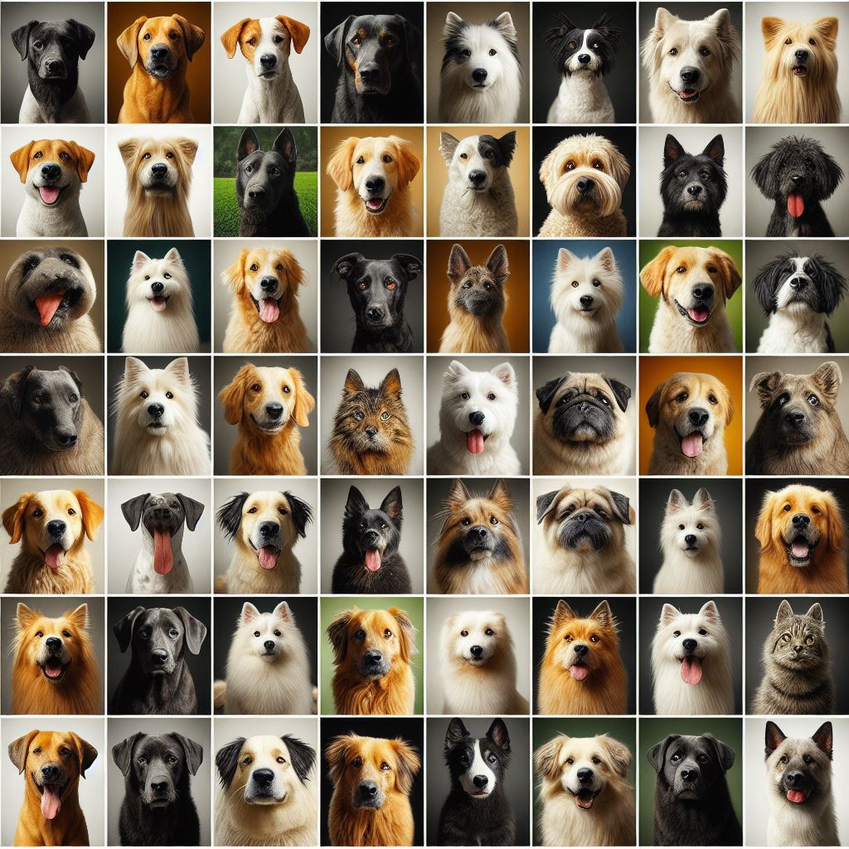
Challenges in machine learning: data availability
Challenge: Finding Enough Data
Example: If you want to teach a computer to recognize different types of dogs, you need lots of pictures of different breeds, poses, and backgrounds.
Addressing Data Availability Challenges:
Collect more data (collaborators, relevant datasets)
Data augmentation (flipping images, adding noise to
audio recordings)
Example: If we don't have enough pictures of dogs,
we can create new ones by changing the colors or
backgrounds of existing pictures.
Notes:
Machine learning models need lots of data to learn from. Sometimes it's hard to find enough data that's diverse and representative of what the model needs to learn, especially in niche or specialized domains (e.g. space biology).
Data Collection Efforts: Researchers and engineers work on collecting more data, either by gathering it themselves or by collaborating with others who have access to relevant data.
Data Augmentation: Sometimes, we can create more data by making small changes to existing data, like flipping images horizontally or adding noise to audio recordings.
Example: If we don't have enough pictures of dogs, we can create new ones by changing the colors or backgrounds of existing pictures.

Slide 7

Challenges in machine learning: generalizability
Challenge: Making Sure It Works Everywhere:
Example: If you teach a computer to recognize cats using only pictures of grey cats, it might not be able to identify cats with other colored fur.
Addressing Generalizability Challenges:
Test models with new data to make sure they work well in different situations
Adjust the model
Get more diverse data
Example: After teaching a computer to recognize cats, we need to show it pictures of cats it hasn't seen before to make sure it can still recognize them correctly.
Notes:
Machine learning models need to be able to perform well not just on the data they were trained on, but also on new, unseen data they haven't encountered before.

Slide 8
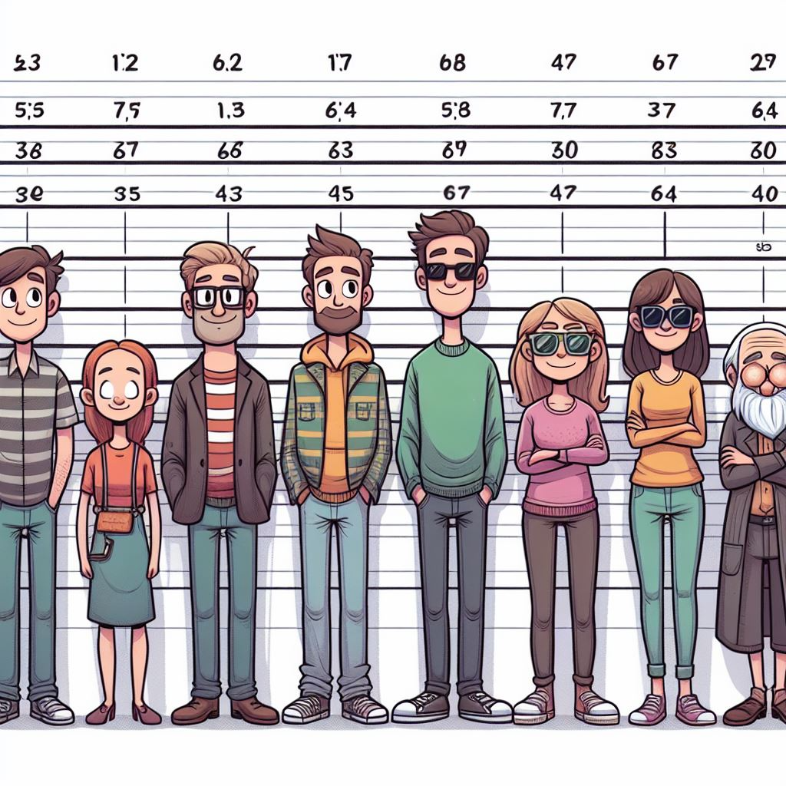
Key concepts in machine learning
Bias: the error introduced by approximating a real-world problem with a simplified model.
Bias is like always assuming that the average height of people is 6 feet, even if the actual data shows a different distribution.

Slide 9

Key concepts in machine learning
Variance: measures the model's sensitivity to fluctuations in the training data.
High variance is like memorizing specific details of a story instead of understanding the main plot.
Notes:
High variance models capture noise or random fluctuations in the data, leading to overfitting. The model becomes too sensitive to minor variations in the data.

Slide 10

Key concepts in machine learning
Interpretability: how a machine learning model makes predictions or decisions.
Interpretability is like being able to explain why a movie recommendation was made, based on factors like genre, actors, or user preferences.
Notes:
The ability to understand or explain how an ml model makes decisions

Slide 11

Key concepts in machine learning
Overfitting: a model learns noise or irrelevant details from the training data, resulting in poor performance on new, unseen data.
Overfitting is like memorizing answers to specific questions from past exams without understanding the concepts. The model performs well on known questions but fails on new ones.
Notes:
Overly complex models with high variance are prone to overfitting

Slide 12

Key concepts in machine learning
Underfitting: when a model is too simple to capture the underlying structure of the data.
Underfitting is like using a simple recipe to cook a complex dish, resulting in a bland or incomplete outcome. The model fails to capture the nuances of the data.
Notes:
Underfit models have high bias and low variance - leading to poor performance on both training and test datasets

